Slide 1
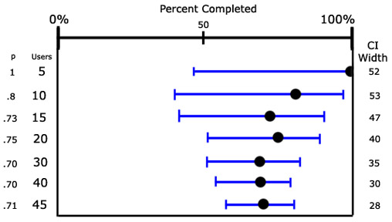
Confidence intervals/proportions
Geog4300/6300
Jerry Shannon

Slide 2
A question…
Let’s say we got property tax rates for 20 random counties in Georgia (out of 159).
The average was 8.085% (with a s.d. of .88)
How close is this to the actual mean?

Slide 3
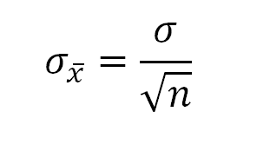
Central Limit Theorem
The sampling distribution, comprised of the means of all possible samples, will:
have a mean that is the same as the population mean
approximate a normal distribution, even if the sample distribution is not normal
have a standard deviation equal to the following formula:

Slide 4
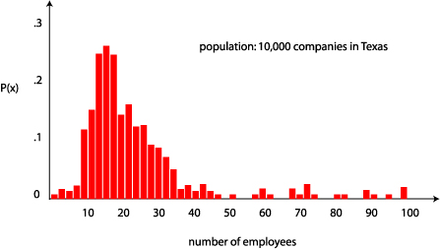
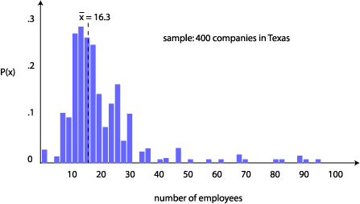
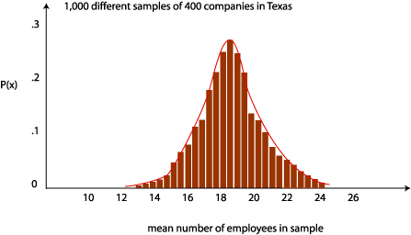
Three types of distributions
Population
Sample
Sampling mean
Our mean is in here somewhere!!

Slide 5

Our mission: Confidence intervals
Goal: be 95% confident that we know what the true mean might be.
We will create a
confidence interval
from these values that will probably include the mean.
Notes:
T distribution was created by William Gosset. Hired in 1902 at Guinness brewery to help maximize quality of beer at a lower cost.
Problem of how to measure taste with only small sample sizes (limit on how much beer one man can drink)
He had to publish his results without his name because of the privacy restrictions Guinness put on their employees. Just the name “Student”.
Thus his statistical method is still known today as Gosset’s t-test.

Slide 6

What we know:
95% of sample means are within 1.96 times the standard error (sd of this distribution)
Notes:
T distribution was created by William Gosset. Hired in 1902 at Guinness brewery to help maximize quality of beer at a lower cost.
Problem of how to measure taste with only small sample sizes (limit on how much beer one man can drink)
He had to publish his results without his name because of the privacy restrictions Guinness put on their employees. Just the name “Student”.
Thus his statistical method is still known today as Gosset’s t-test.

Slide 7
The reverse is also true!
For 95% of sample means, the true mean is within 1.96 times the standard error.
Notes:
T distribution was created by William Gosset. Hired in 1902 at Guinness brewery to help maximize quality of beer at a lower cost.
Problem of how to measure taste with only small sample sizes (limit on how much beer one man can drink)
He had to publish his results without his name because of the privacy restrictions Guinness put on their employees. Just the name “Student”.
Thus his statistical method is still known today as Gosset’s t-test.

Slide 8
What will confidence intervals tell us?
95% of the time, this confidence interval around the sample mean will include the true mean
Notes:
T distribution was created by William Gosset. Hired in 1902 at Guinness brewery to help maximize quality of beer at a lower cost.
Problem of how to measure taste with only small sample sizes (limit on how much beer one man can drink)
He had to publish his results without his name because of the privacy restrictions Guinness put on their employees. Just the name “Student”.
Thus his statistical method is still known today as Gosset’s t-test.

Slide 9
A question (again)…
Let’s say we got property tax rates for 20 random counties in Georgia (out of 159).
The average was 8.085% (with a s.d. of .88)
How close is this to the actual mean?

Slide 10
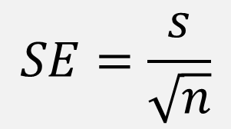
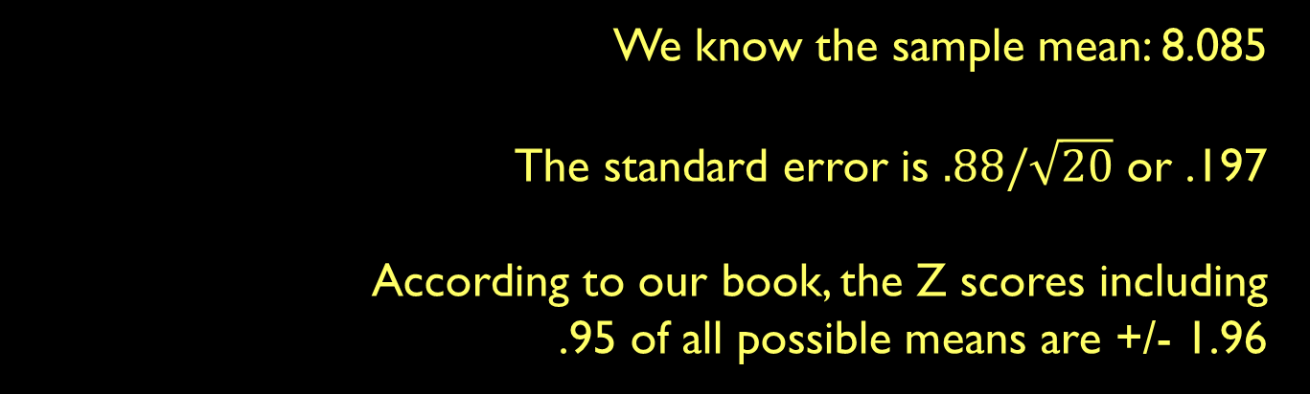
Our mission: Confidence intervals
Three ingredients for a confidence interval:
Sample mean
Standard error
Z-score for the confidence interval
Notes:
T distribution was created by William Gosset. Hired in 1902 at Guinness brewery to help maximize quality of beer at a lower cost.
Problem of how to measure taste with only small sample sizes (limit on how much beer one man can drink)
He had to publish his results without his name because of the privacy restrictions Guinness put on their employees. Just the name “Student”.
Thus his statistical method is still known today as Gosset’s t-test.

Slide 11
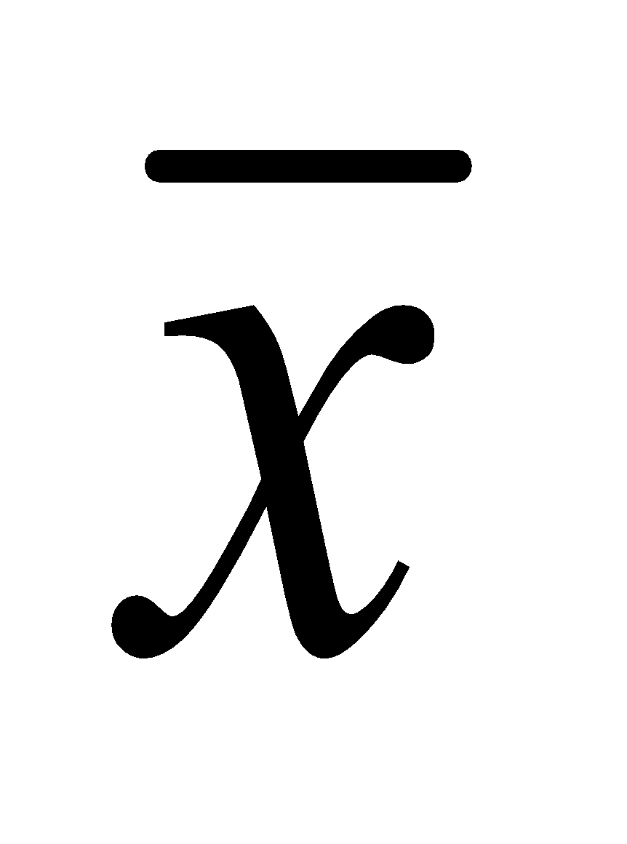
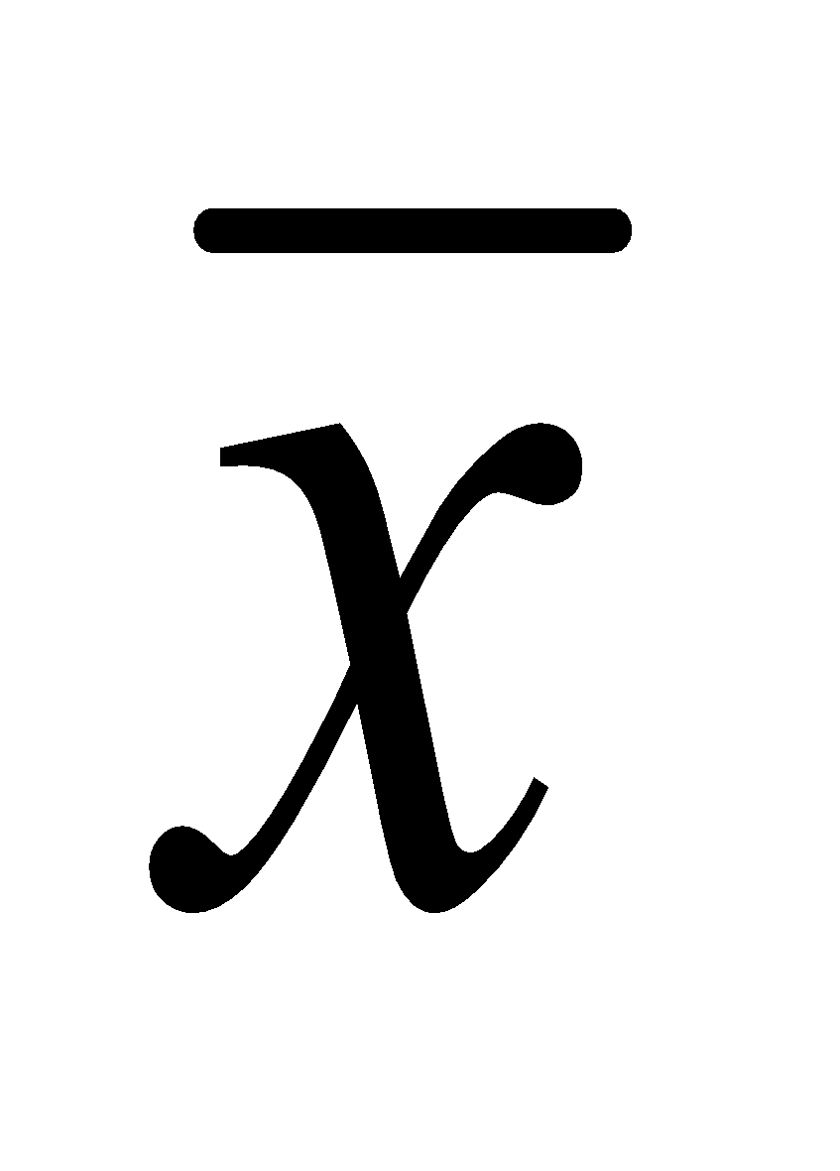
To make a confidence interval
- (z * SE) < μ < + + (z * SE)
In our case, 8.08 – (1.96 * 0.197) < μ < 8.08 + (1.96 * 0.197) 7.69 < μ < 8.47
We are 95% certain that the true mean lies somewhere in this range
Notes:
T distribution was created by William Gosset. Hired in 1902 at Guinness brewery to help maximize quality of beer at a lower cost.
Problem of how to measure taste with only small sample sizes (limit on how much beer one man can drink)
He had to publish his results without his name because of the privacy restrictions Guinness put on their employees. Just the name “Student”.
Thus his statistical method is still known today as Gosset’s t-test.

Slide 12
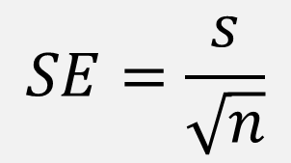
Try it out
- z * SE < μ < + z * SE
Roll your dice 15 times and calculate the mean and standard deviation.
What’s the confidence interval for this result? Does it include the actual mean (7)?
Notes:
T distribution was created by William Gosset. Hired in 1902 at Guinness brewery to help maximize quality of beer at a lower cost.
Problem of how to measure taste with only small sample sizes (limit on how much beer one man can drink)
He had to publish his results without his name because of the privacy restrictions Guinness put on their employees. Just the name “Student”.
Thus his statistical method is still known today as Gosset’s t-test.

Slide 13
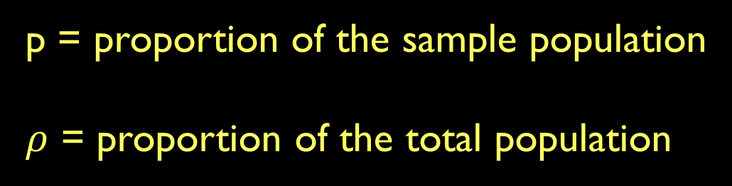
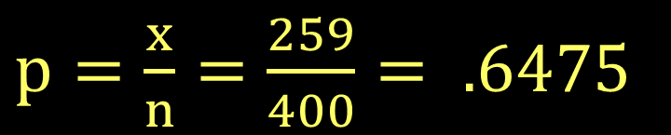
What if you have a proportion?
When 400 geographers were polled, 259 of them voted for holding the next AAG convention in Maui. What’s the actual opinion on this issue?
Notes:
T distribution was created by William Gosset. Hired in 1902 at Guinness brewery to help maximize quality of beer at a lower cost.
Problem of how to measure taste with only small sample sizes (limit on how much beer one man can drink)
He had to publish his results without his name because of the privacy restrictions Guinness put on their employees. Just the name “Student”.
Thus his statistical method is still known today as Gosset’s t-test.

Slide 14
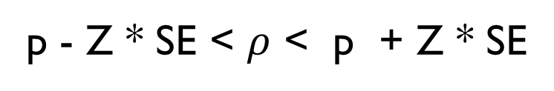
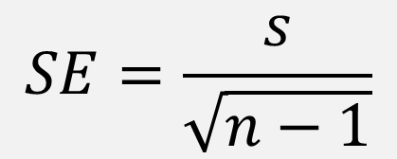
When 400 geographers were polled, 259 of them voted for holding the next AAG convention in Maui. What’s the actual opinion on this issue?
!Alert!
Data doesn’t have a standard deviation!
Standard error will not compute!
Notes:
T distribution was created by William Gosset. Hired in 1902 at Guinness brewery to help maximize quality of beer at a lower cost.
Problem of how to measure taste with only small sample sizes (limit on how much beer one man can drink)
He had to publish his results without his name because of the privacy restrictions Guinness put on their employees. Just the name “Student”.
Thus his statistical method is still known today as Gosset’s t-test.

Slide 15
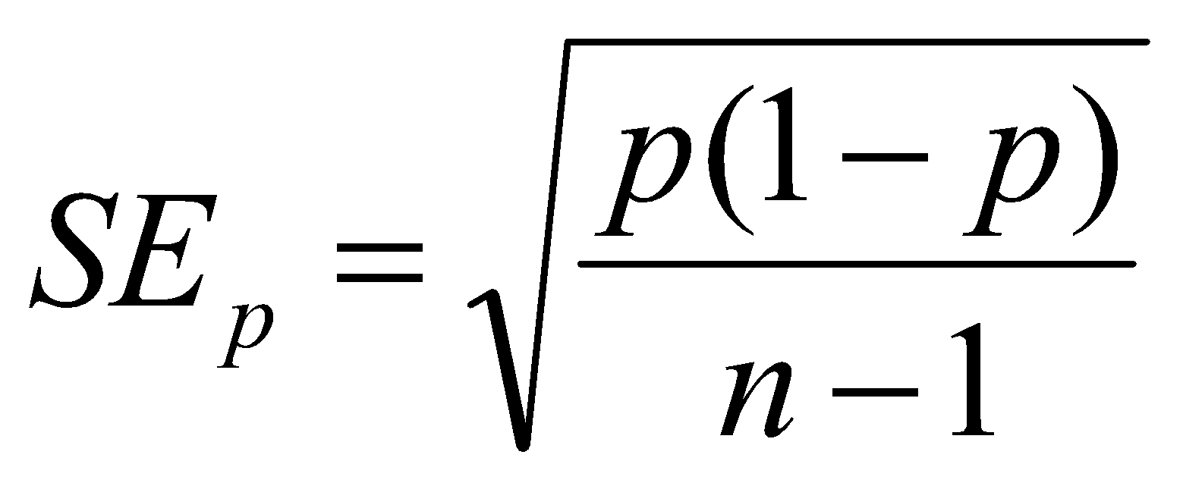
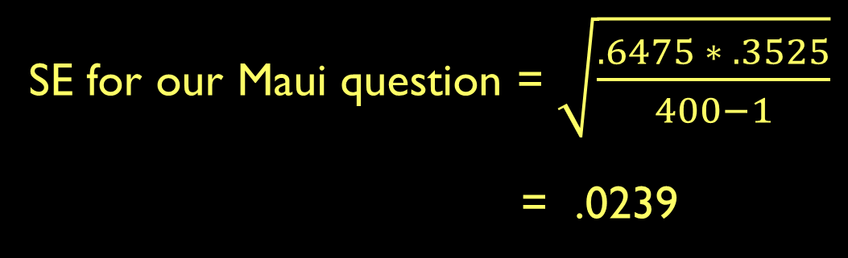
Standard error for proportions
Notes:
T distribution was created by William Gosset. Hired in 1902 at Guinness brewery to help maximize quality of beer at a lower cost.
Problem of how to measure taste with only small sample sizes (limit on how much beer one man can drink)
He had to publish his results without his name because of the privacy restrictions Guinness put on their employees. Just the name “Student”.
Thus his statistical method is still known today as Gosset’s t-test.

Slide 16
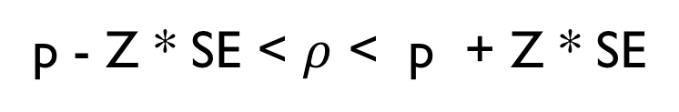
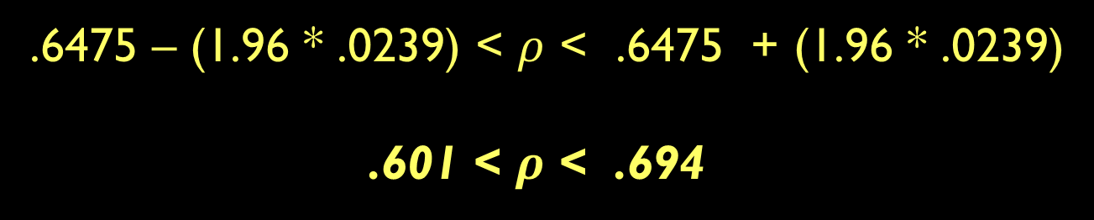
When 400 geographers were polled, 259 of them voted for holding the next AAG convention in Maui. What’s the actual opinion on this issue?
Notes:
T distribution was created by William Gosset. Hired in 1902 at Guinness brewery to help maximize quality of beer at a lower cost.
Problem of how to measure taste with only small sample sizes (limit on how much beer one man can drink)
He had to publish his results without his name because of the privacy restrictions Guinness put on their employees. Just the name “Student”.
Thus his statistical method is still known today as Gosset’s t-test.

Slide 17
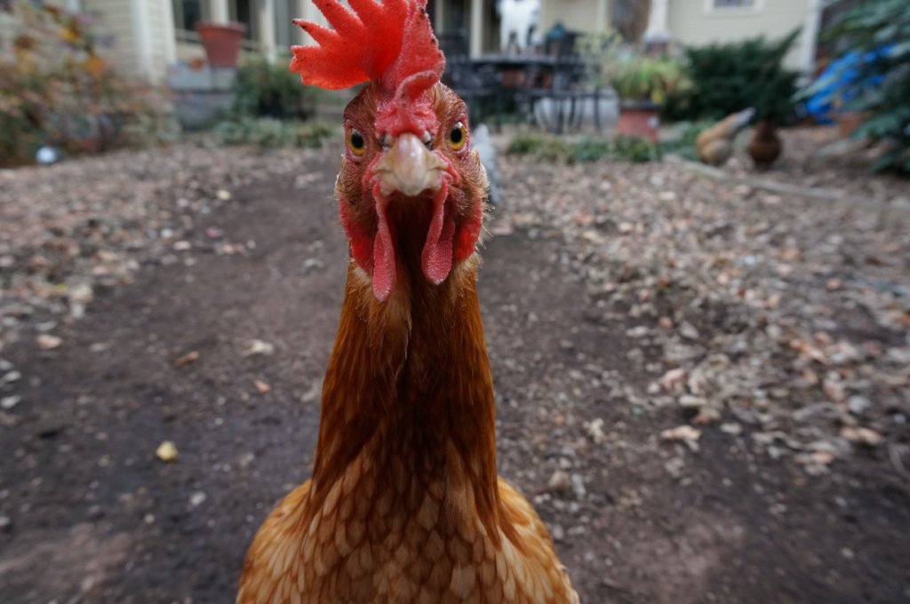
You asked 50 households in Athens if they keep chickens on their property. Three said they did. Create a confidence interval for the proportion of chicken owning households in the city.
Notes:
T distribution was created by William Gosset. Hired in 1902 at Guinness brewery to help maximize quality of beer at a lower cost.
Problem of how to measure taste with only small sample sizes (limit on how much beer one man can drink)
He had to publish his results without his name because of the privacy restrictions Guinness put on their employees. Just the name “Student”.
Thus his statistical method is still known today as Gosset’s t-test.

Slide 18
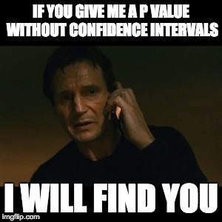
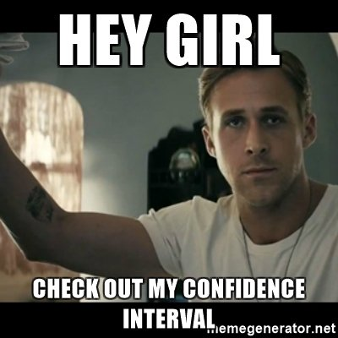
Confidence intervals in R
Notes:
T distribution was created by William Gosset. Hired in 1902 at Guinness brewery to help maximize quality of beer at a lower cost.
Problem of how to measure taste with only small sample sizes (limit on how much beer one man can drink)
He had to publish his results without his name because of the privacy restrictions Guinness put on their employees. Just the name “Student”.
Thus his statistical method is still known today as Gosset’s t-test.

